Slide 1
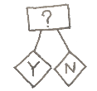
Knowledge Organiser | Subject: Science | Topic: Electricity | Year 4
Key Knowledge & Vocabulary
Electricity can be generated in different ways. In power stations, turbines generate large amounts of electricity. In batteries, chemical reactions generate smaller amounts of electricity.
Circuits can be made using batteries, wires and electrical components, including bulbs, buzzers and motors. They change electrical energy in light energy (bulbs), sound energy (buzzers) or kinetic energy (motor).
Some materials conduct electricity through them – metals are generally good conductors of electricity. Insulators do not let electricity through them – these materials include plastic, wood, glass and rubber.
Working Scientifically
Fair testing
Observing over time
Researching
Classifying, identifying and comparing
Exploring
Seeking patterns
Which did you use in science lessons and why?
Key Concepts
Materials | Electricity | Power source | Circuit | Electrical component | Switch | Conductors and Insulators | Robots
Objects are made of materials, sometimes only one, sometimes more than one. Materials can have different properties. | Everything is made up of tiny particles, which may have positive or negative charges. Electricity is the presence or flow of these particles. | A circuit always needs a power source, such as a battery, with wires connected to both the positive (+) and negative (-) ends. | Electricity can flow through the components in a complete electrical We use electric currents to control and operate devices, including phones, computers and light bulbs. | A circuit can also contain other electrical components e.g. bulbs, buzzers or motors. These allow electricity to pass through. | A switch in a circuit to create a gap in a circuit. This can be used to switch it on and off. | Conductors let electricity pass through them easily. Insulators do not allow electricity to pass through them. | Robots are machines. There are lots of types of robots. They move in different ways and do all kinds of jobs.
Linking Thinking Across Our Learning Journey
Nursery | Reception | Year 1 | Year 2 | Year 3 | Year 4 | Year 5 | Year 6
Cause and effect | Cause and effect | Everyday materials | Everyday materials | Magnets | Electricity | Space | Forces

Slide 2
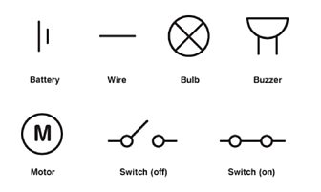
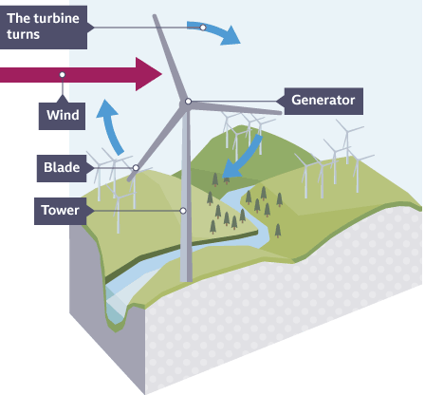
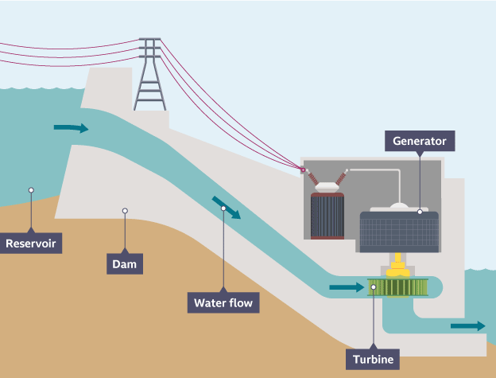
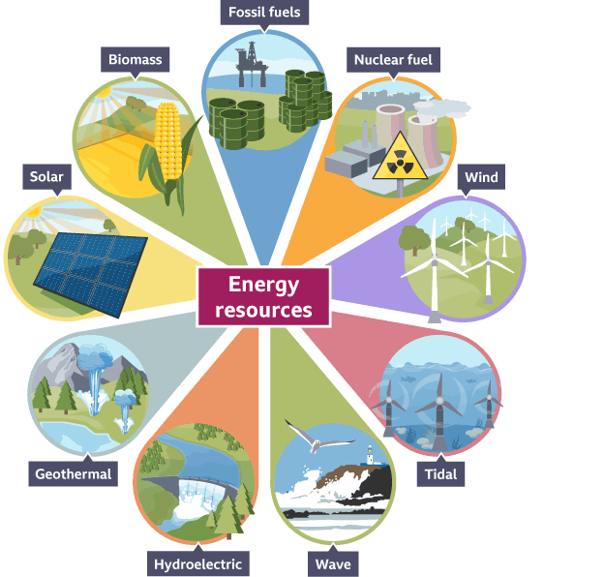
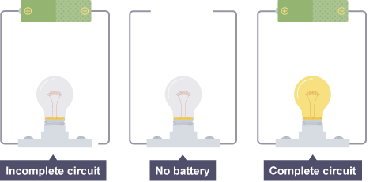
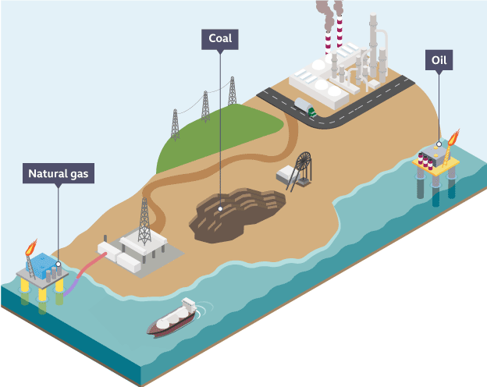
Electrical symbols
Wind power
Hydroelectricity
Energy resources
Circuits
Fossil fuels

