Slide 1
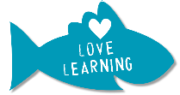
Knowledge Organiser | Subject: Science | Topic: Evolution and inheritance | Year 6
Key Knowledge & Vocabulary
The adaptations of organisms allow them to thrive in different habitats, including extreme environments.
Evolution explains how better adapted organisms have an advantage and are more likely to have offspring with this same adaptation.
Variation is the slight changes in some organisms of the same species. Over time this process gives rise to new species of organisms. This is called evolution.
Extinction occurs when all organisms of a species die out. This may be because the organisms were not able to adapt to changing conditions fast enough.
Fossils are the preserved remains or traces of a dead organism. They provide evidence for how living things and the environment have changed over time.
Working Scientifically
Fair testing
Observing over time
Researching
Classifying, identifying and comparing
Exploring
Seeking patterns
Which did you use in science lessons and why?
Key Concepts
Classification | Fossils | Offspring | Adaptation | Evolution | Reproduction
Broad groupings, such as micro-organisms, plants and animals can be subdivided. Scientists such as Carl Linnaeus and Charles Darwin developed ideas about classifying living things. | Fossils provide information about living things that inhabited the Earth millions of years ago | Offspring are the young of a species. Normally offspring vary and are not identical to their parents, but they share certain characteristics | Animals and plants are adapted to suit their environment in different ways and that adaptation may lead to evolution. | Living things on Earth have changed over time. The process of natural selection means that variation in offspring over time can make living things more or less able to survive in particular environments. | There are different types of reproduction, including sexual and asexual reproduction in plants, and sexual reproduction in animals.
Linking Thinking Across Our Learning Journey
Nursery | Reception | Year 1 | Year 2 | Year 3 | Year 4 | Year 5 | Year 6
Self-care and healthy bodies | Self-care and healthy bodies | Am I an animal? | Living things and habitats | Life cycles of plants | Classification | The human body | Evolution and inheritance

Slide 2
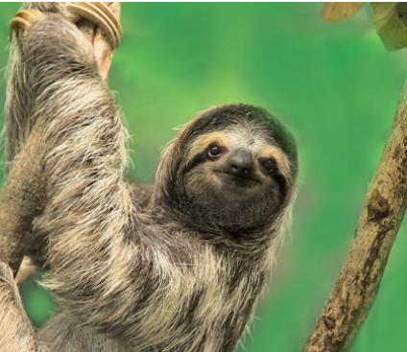
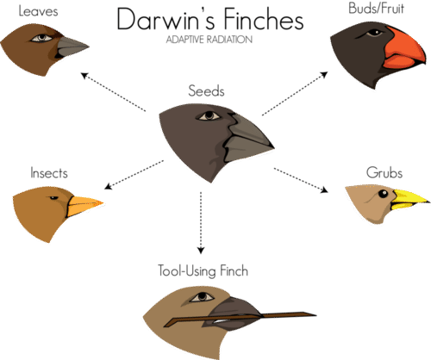
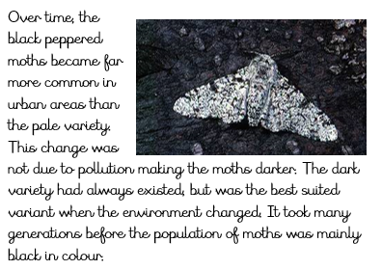
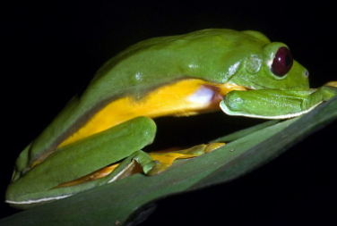
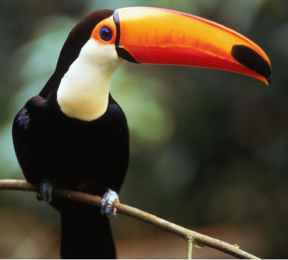
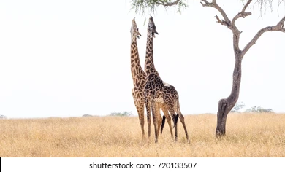
Darwin’s Finches
Peppered Moth
Sloth - adaptations
The sloth is well camouflaged and moves slowly which makes it difficult for predators to spot. This also means it uses little energy.
Toucan- adaptations
Flying frog - adaptations
Giraffe- adaptations
The flying frog has fully webbed hands and feet and a flap of loose skin that stretches between its limbs, which allows it to glide from plant to plant.
Over many years, giraffes were born with longer necks. These giraffes survived better than the giraffes with the shorter necks, and eventually all of the giraffes had long necks.
The toucan has a long, large bill to allow it to reach and cut fruit from branches which are too weak to support its weight.

